Slide 1
TECHNOLOGY & RESEARCH TRENDS
Dr. Achmad Solichin, S.Kom., M.T.I
PEMENANG QUIZ
Artificial
Intelligence
2021
IN

Slide 2
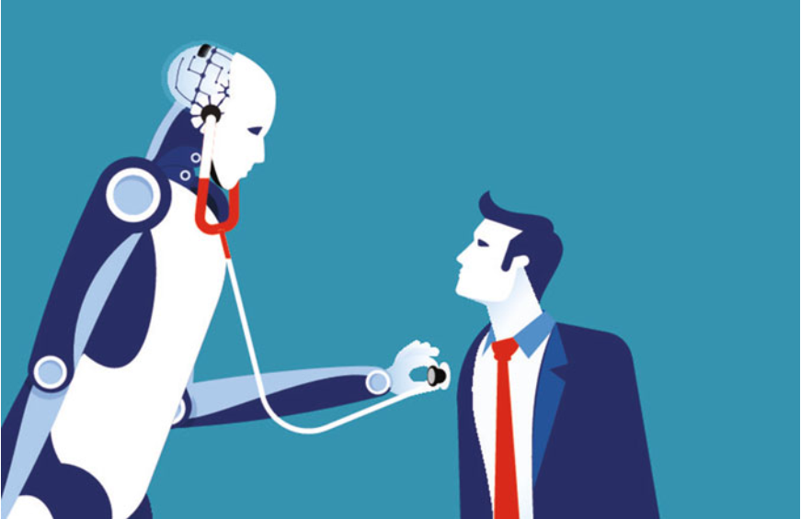
So, can AI replace a real doctor?
QUIZ #1

Slide 3
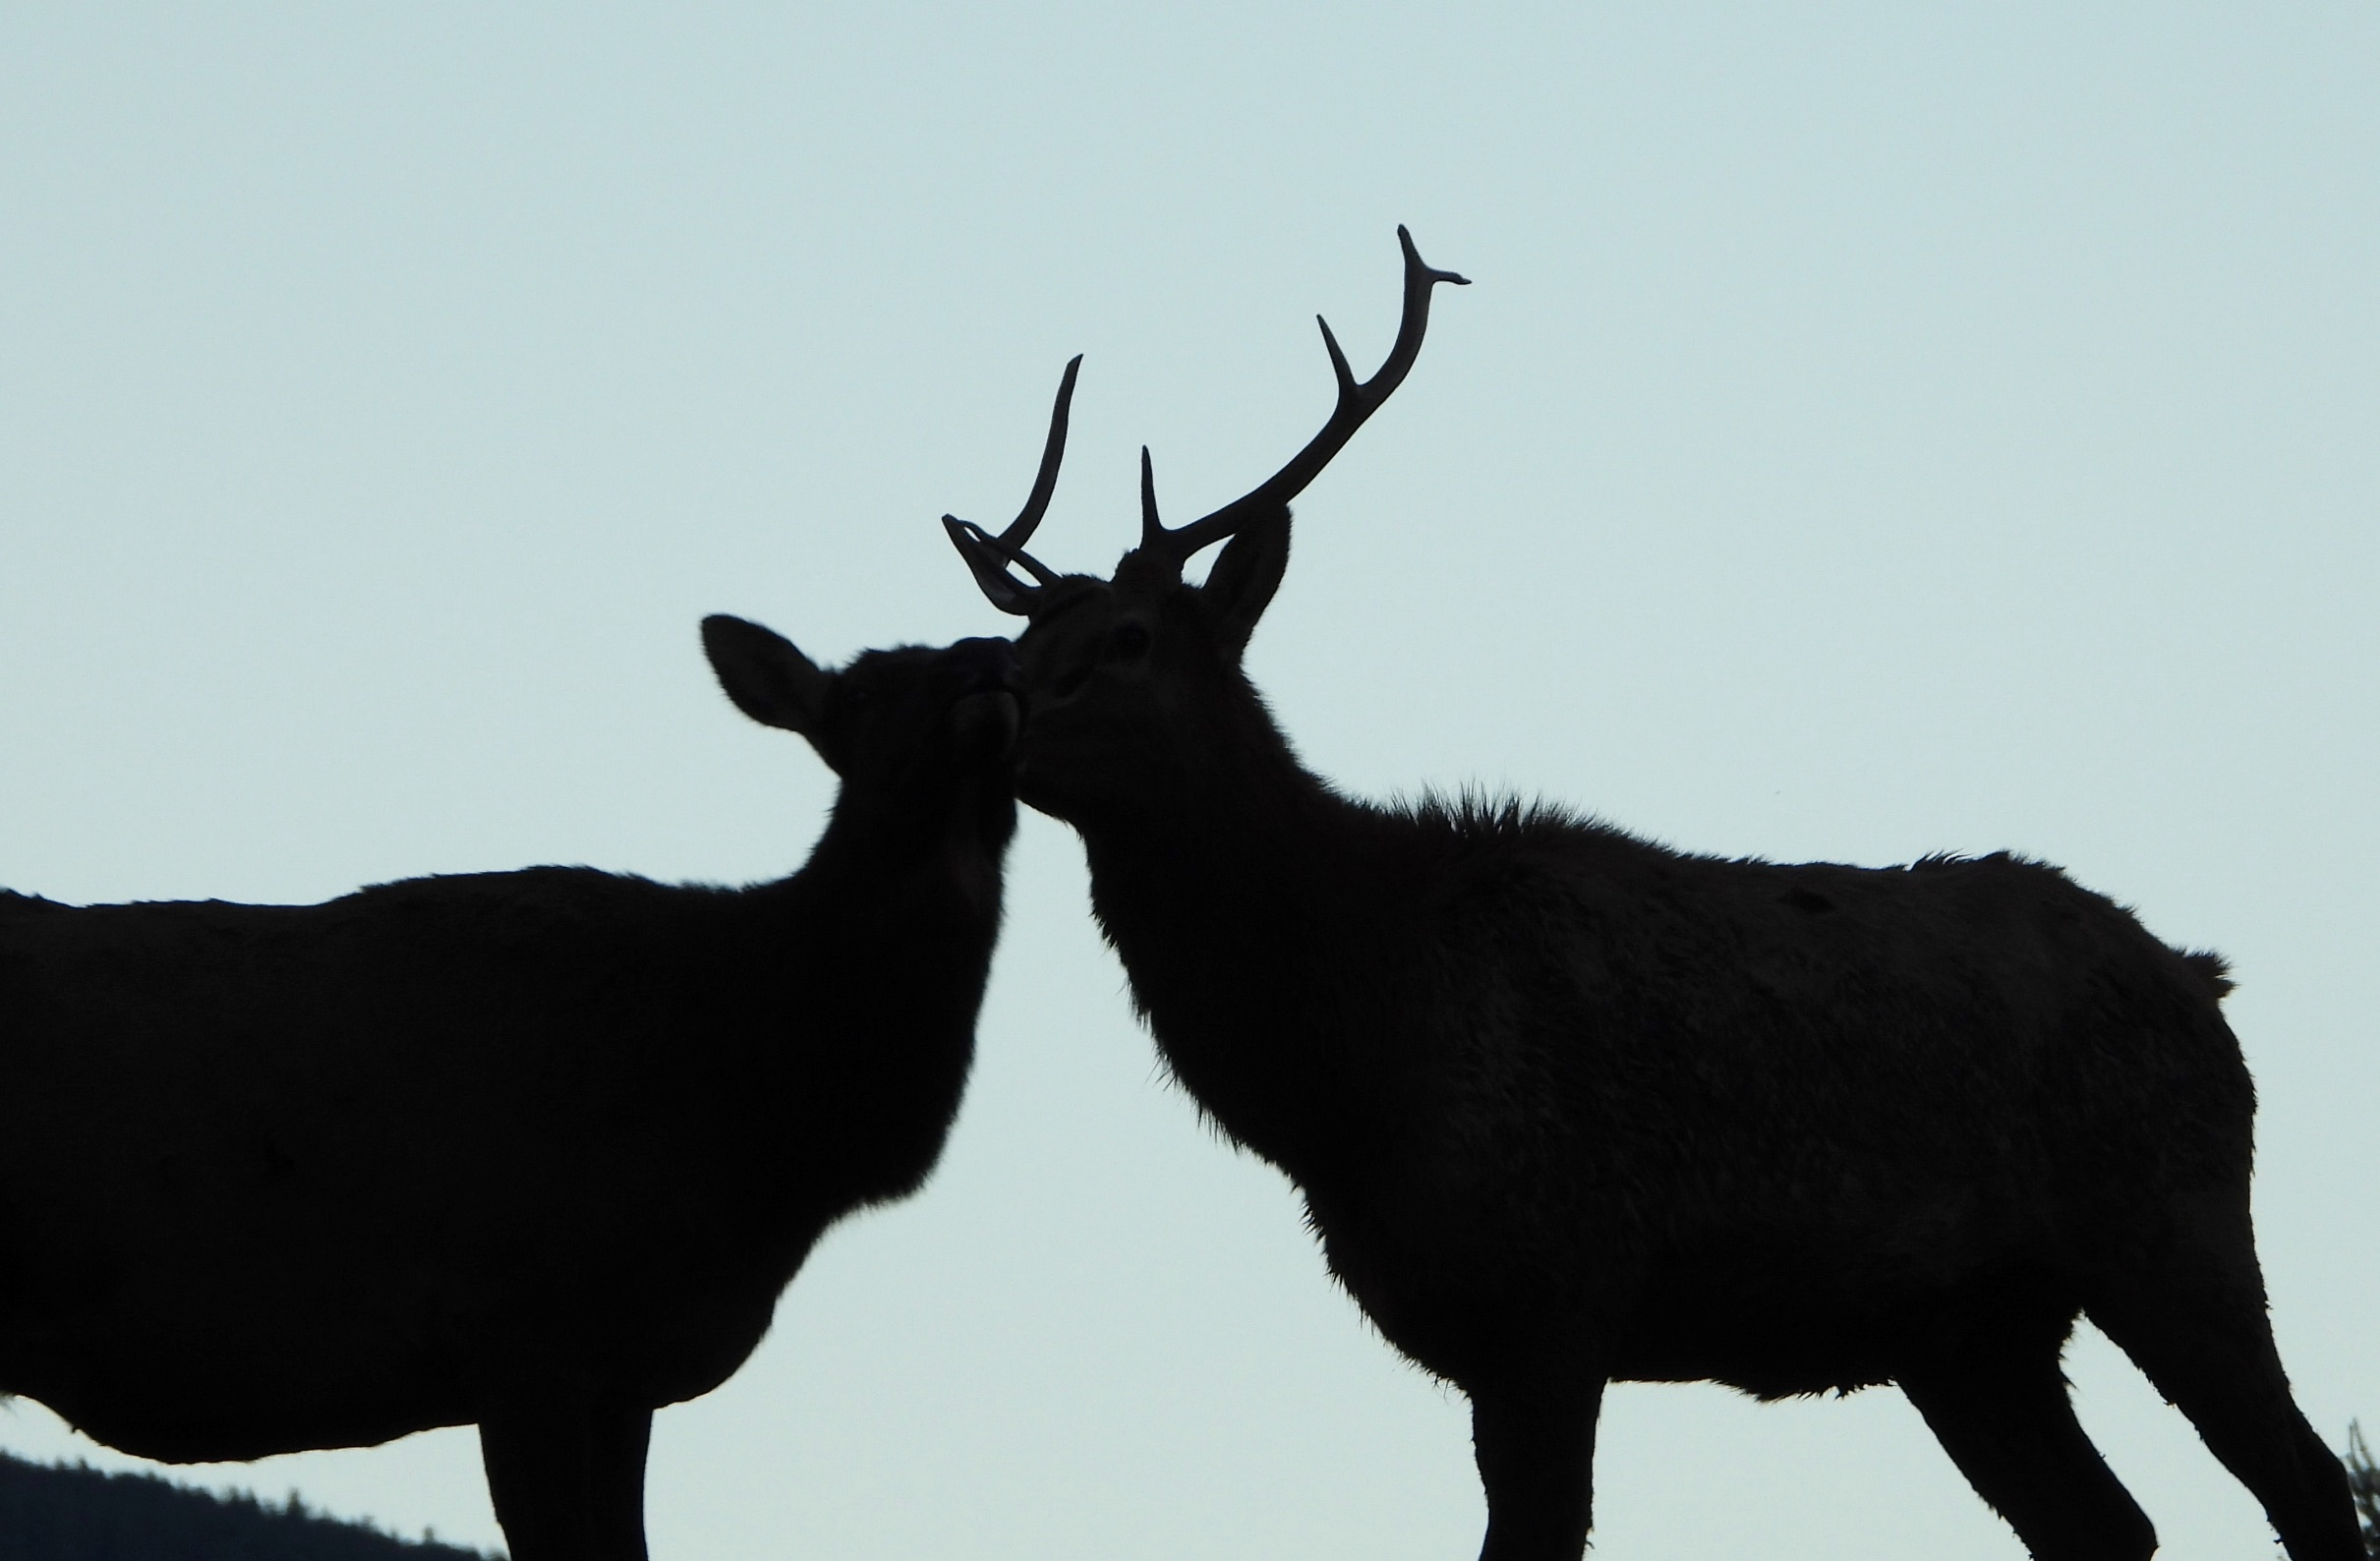
One day, will AI be able to understand animal language? Your opinion?
QUIZ #2

Slide 4
How is the implementation of a smart campus in Indonesia? Is there any?
QUIZ #3

Slide 5
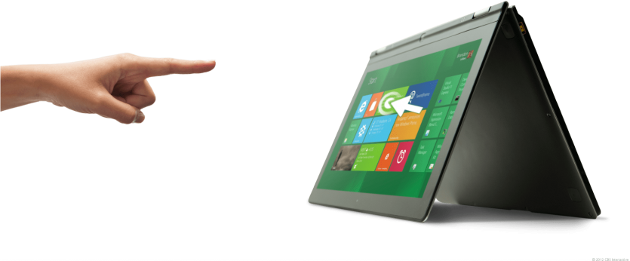
Can you find any examples/ideas of technology that might be replaced by touchless technology?
QUIZ #4

Slide 6
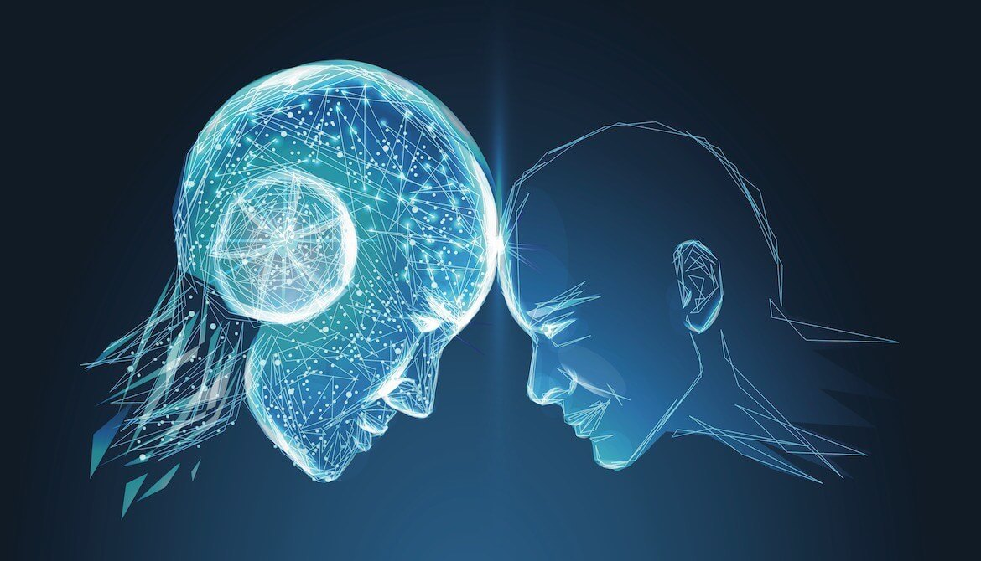
In Your Opinion, will AI one day equal or surpass human intelligence? Should there be rules or laws limiting the development of AI?
QUIZ #5

Slide 7
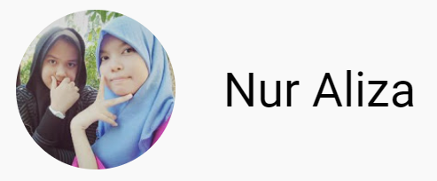
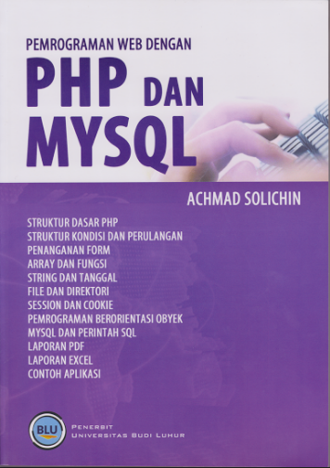
Selamat untuk Pemenang Quiz AI

Slide 8
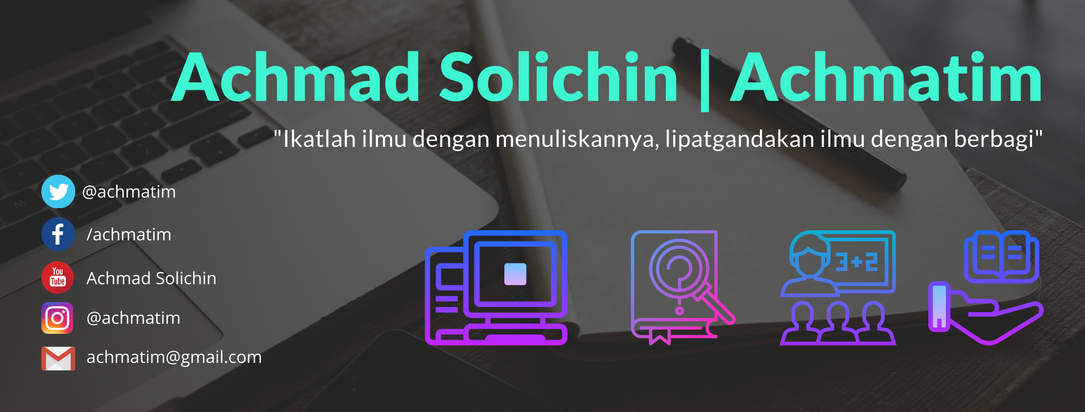
TERIMA KASIH | SEMOGA BERMANFAAT

